Slide 1
WELCOME TO Croatia
VITAJTE
VÄLKOMMEN
RECEBER
BIENVENIDOS

Slide 2
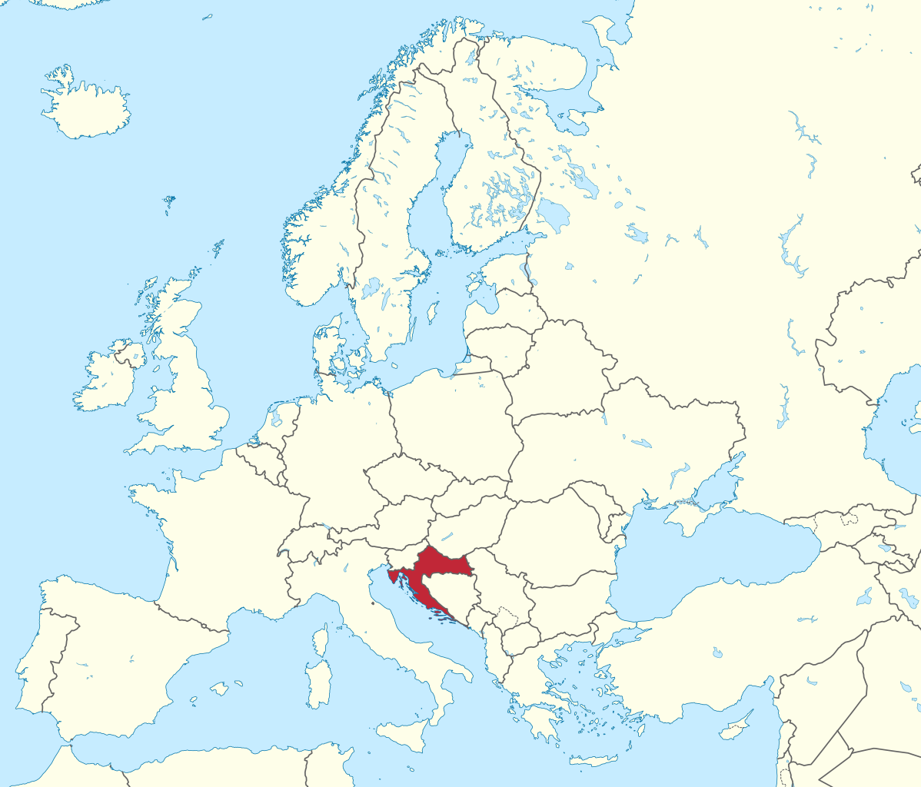
CROATIA IS
on the crossroads between Central Europe and Mediterranean Sea

Slide 3
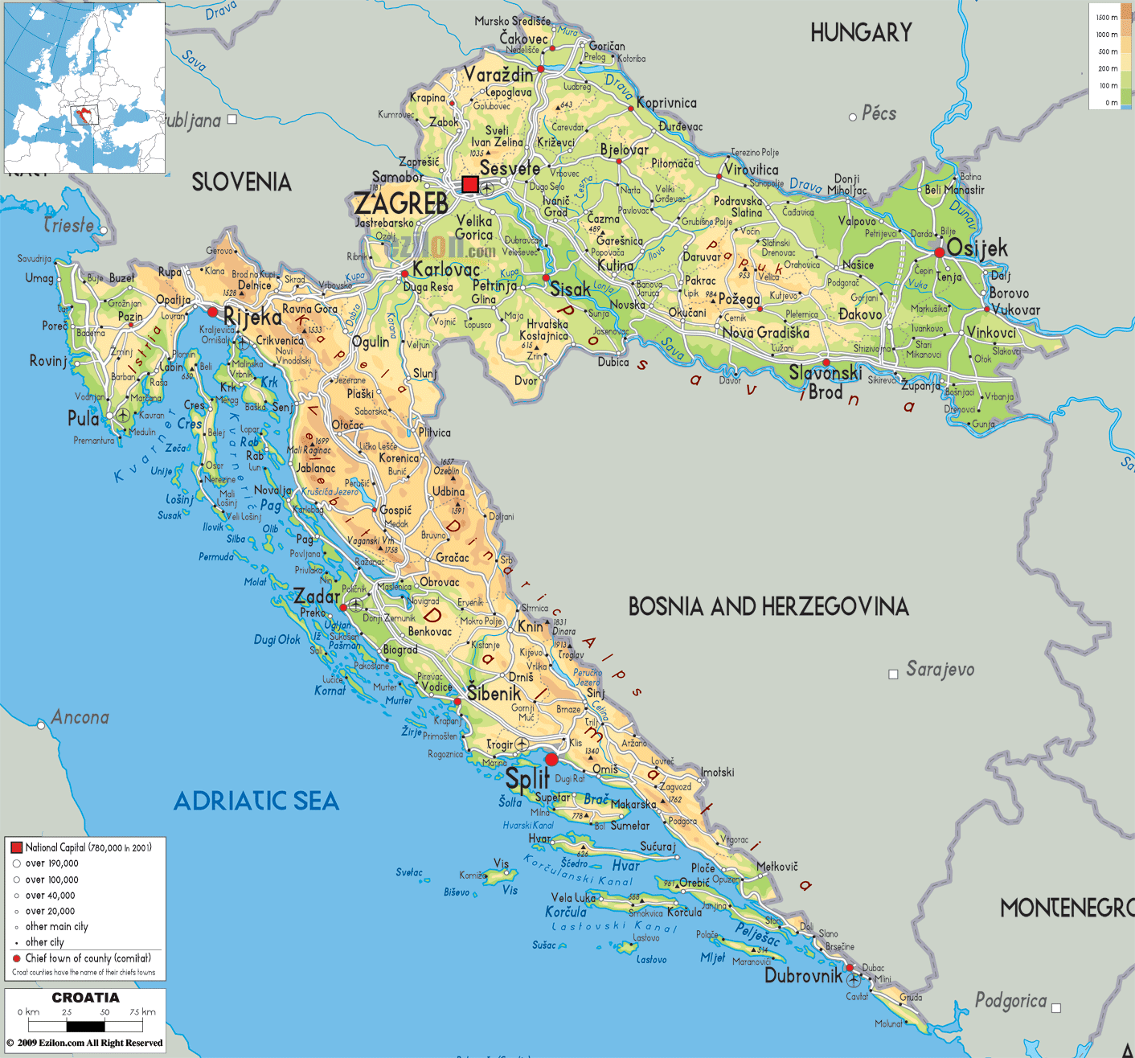
GENERAL FACTS
official name: The Republic of Croatia
official language: Croatian
approximately 4 million inhabitants

Slide 4
CAPITAL - ZAGREB

Slide 5
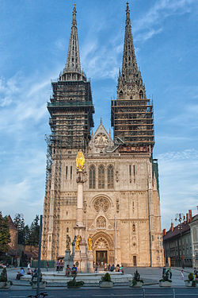
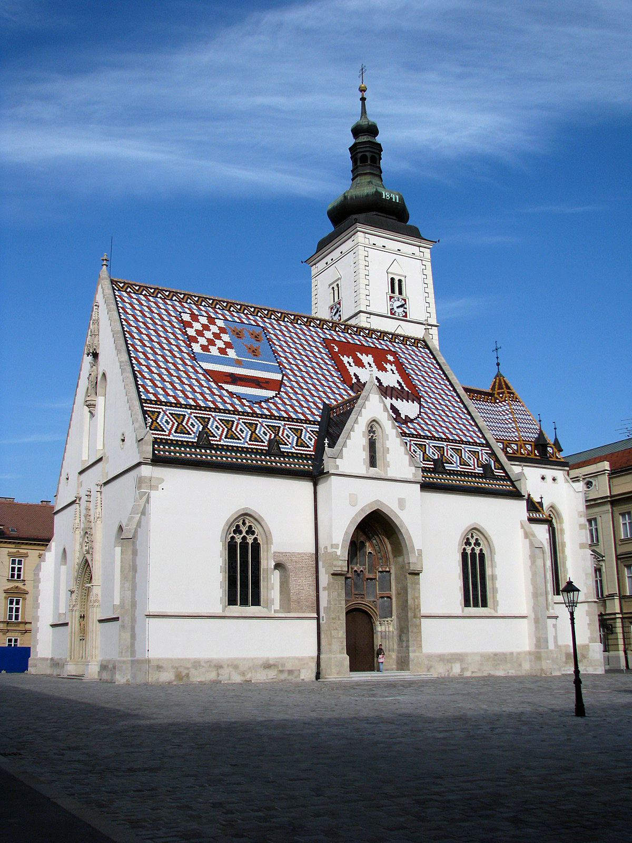
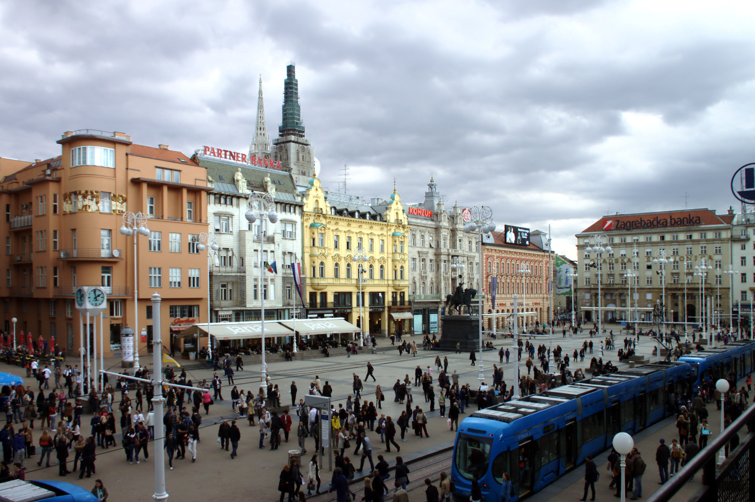
Cathedral
St Mark's church
Ban Jelačić Square

Slide 6
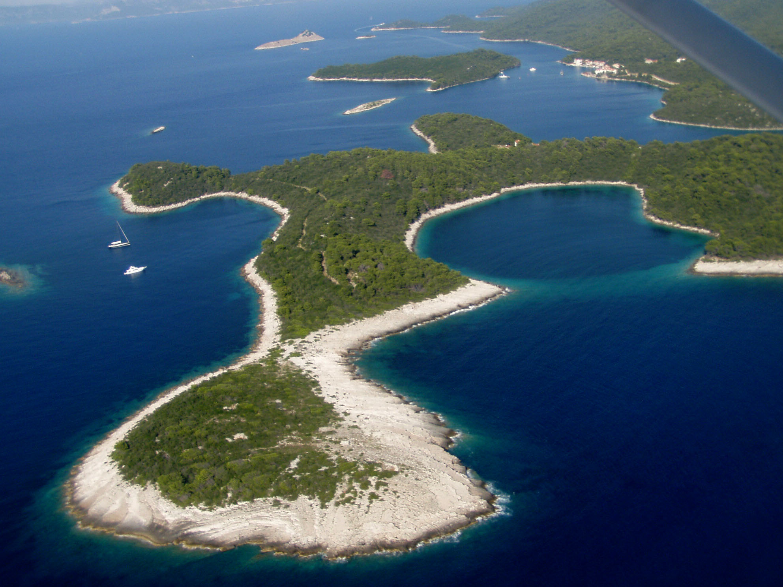
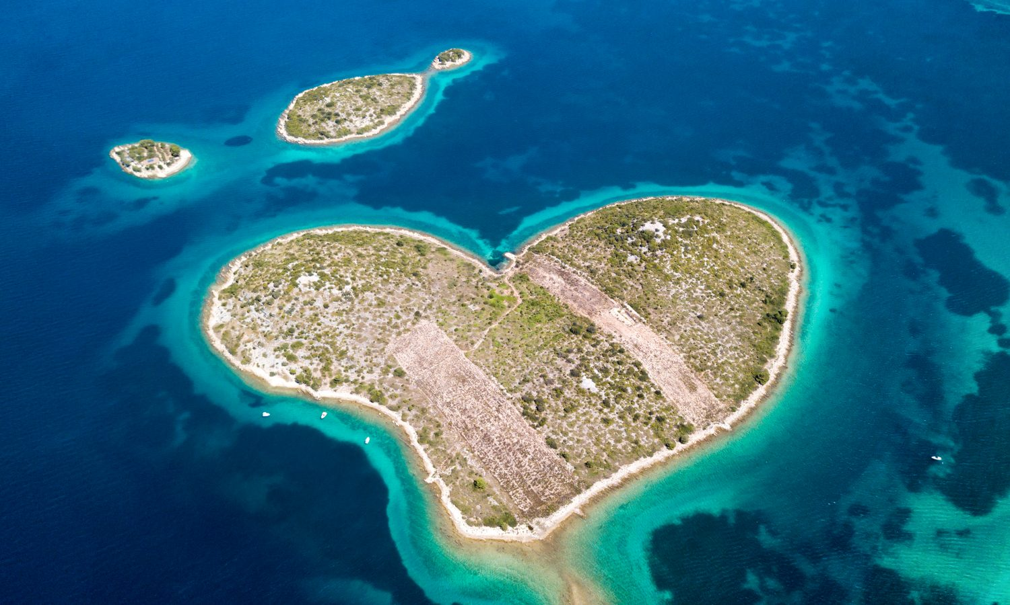
CROATIA – THE LAND OF 1000 ISLANDS
1185 islands – 66 inhabited
one of 10 nations in the world with more than 1000 islands

Slide 7
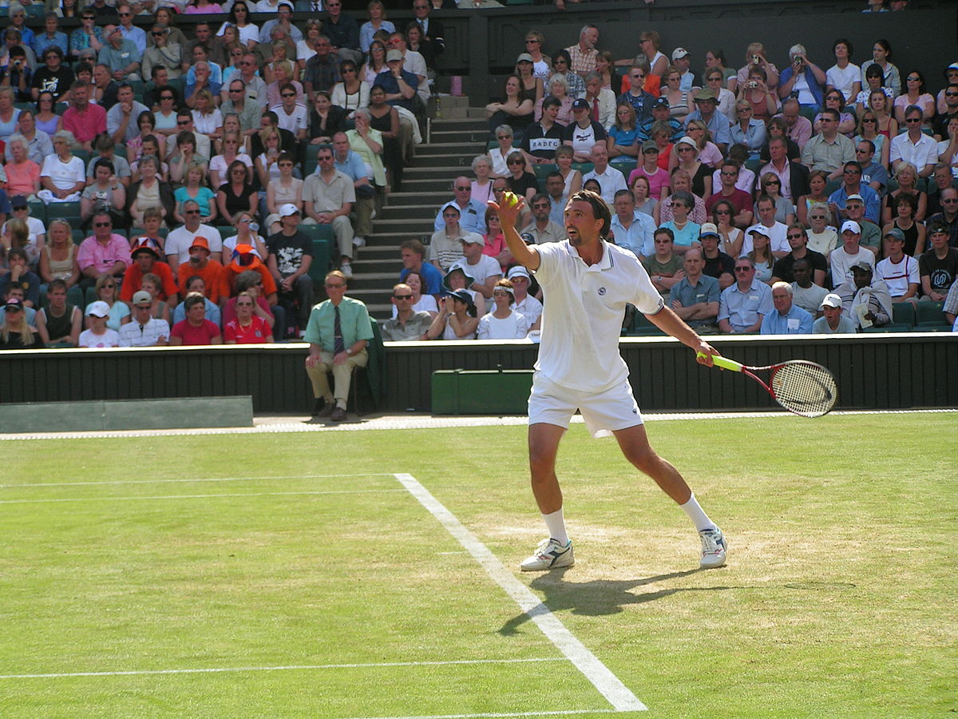
INTERESTING FACTS
Goran Ivanišević - famous tennis player – won Wimbledon Championship in 2001

Slide 8
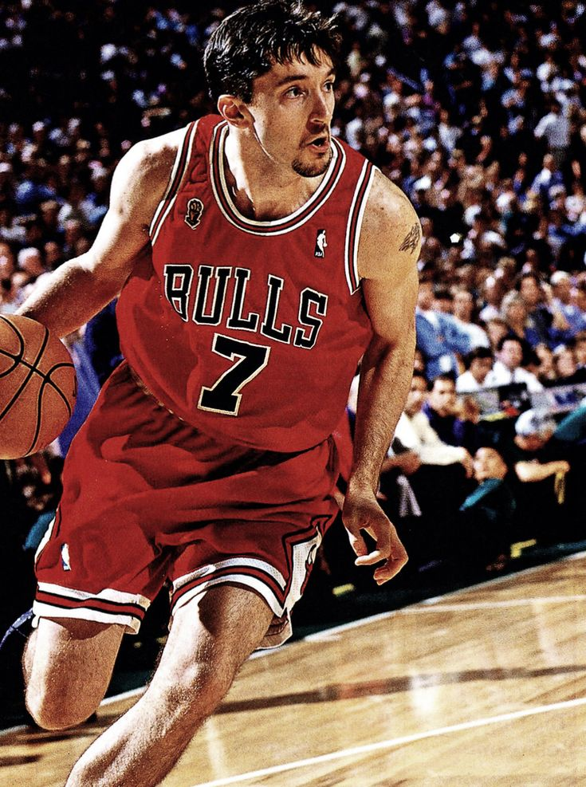
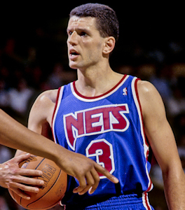
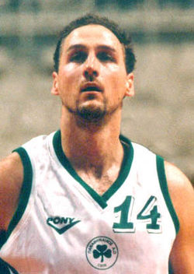
NBA players from Croatia
Toni Kukoč
Dražen Petrović
Dino Rađa

Slide 9
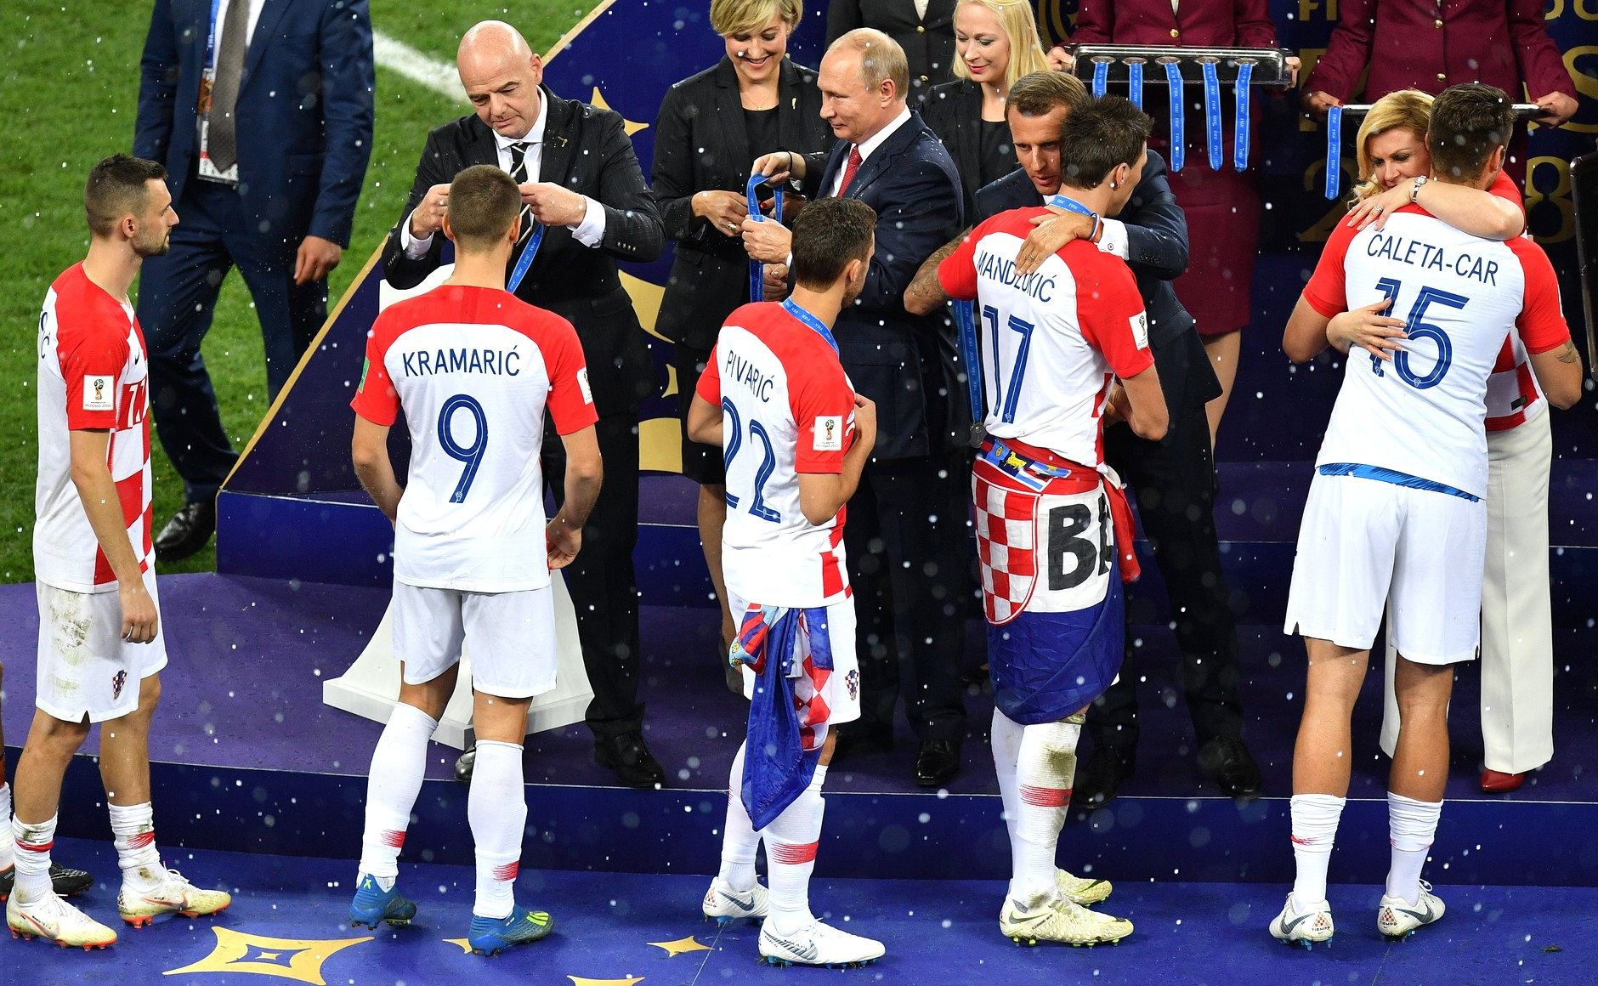
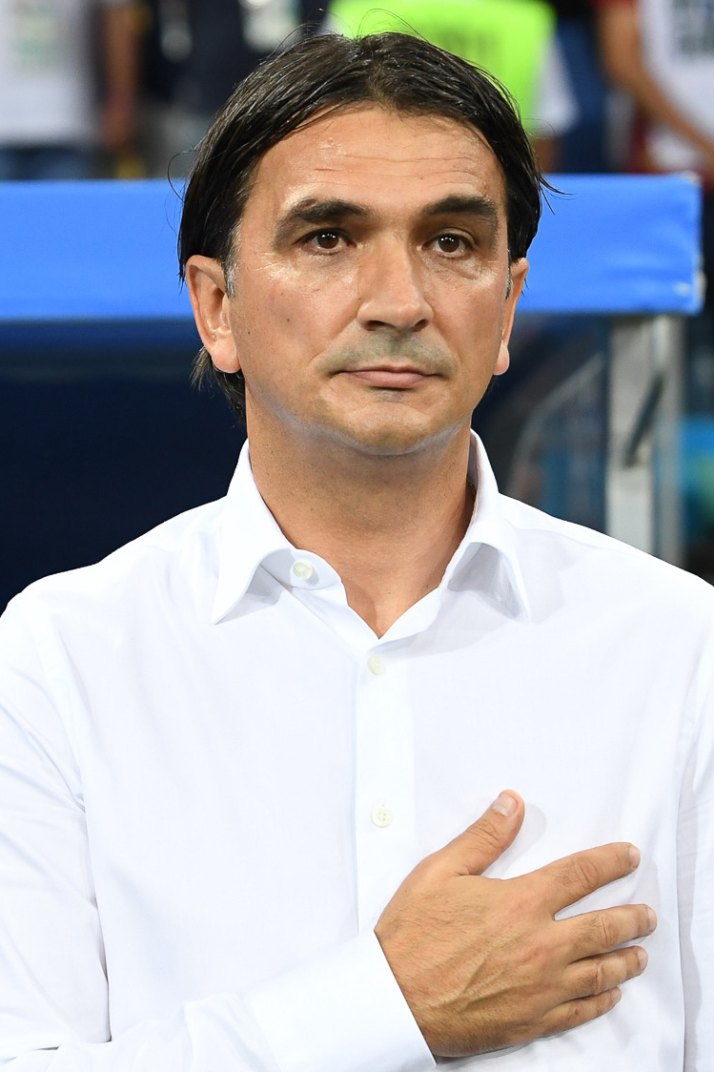
Croatian national football team – 2nd – FIFA World Cup Russia – 2018

Slide 10
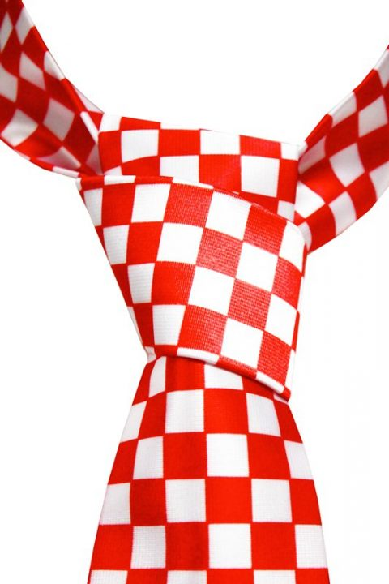
Croatia – home of "tie" - 17th century

Slide 11
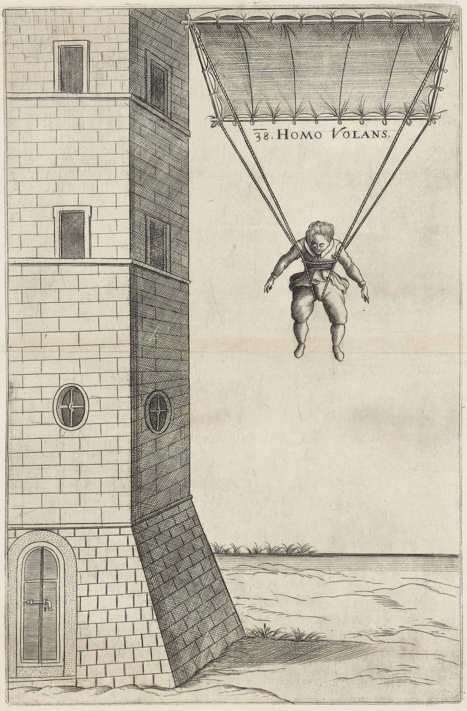
parachute – invented by Faust Vrančić - 16th century

Slide 12
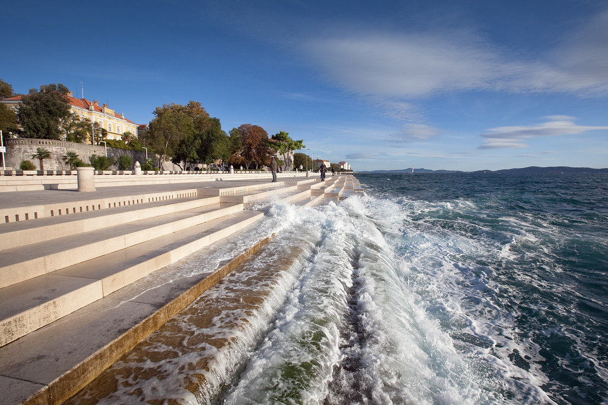
world's first Sea Organ – creates music only by the action of the wind and waves – Zadar

Slide 13
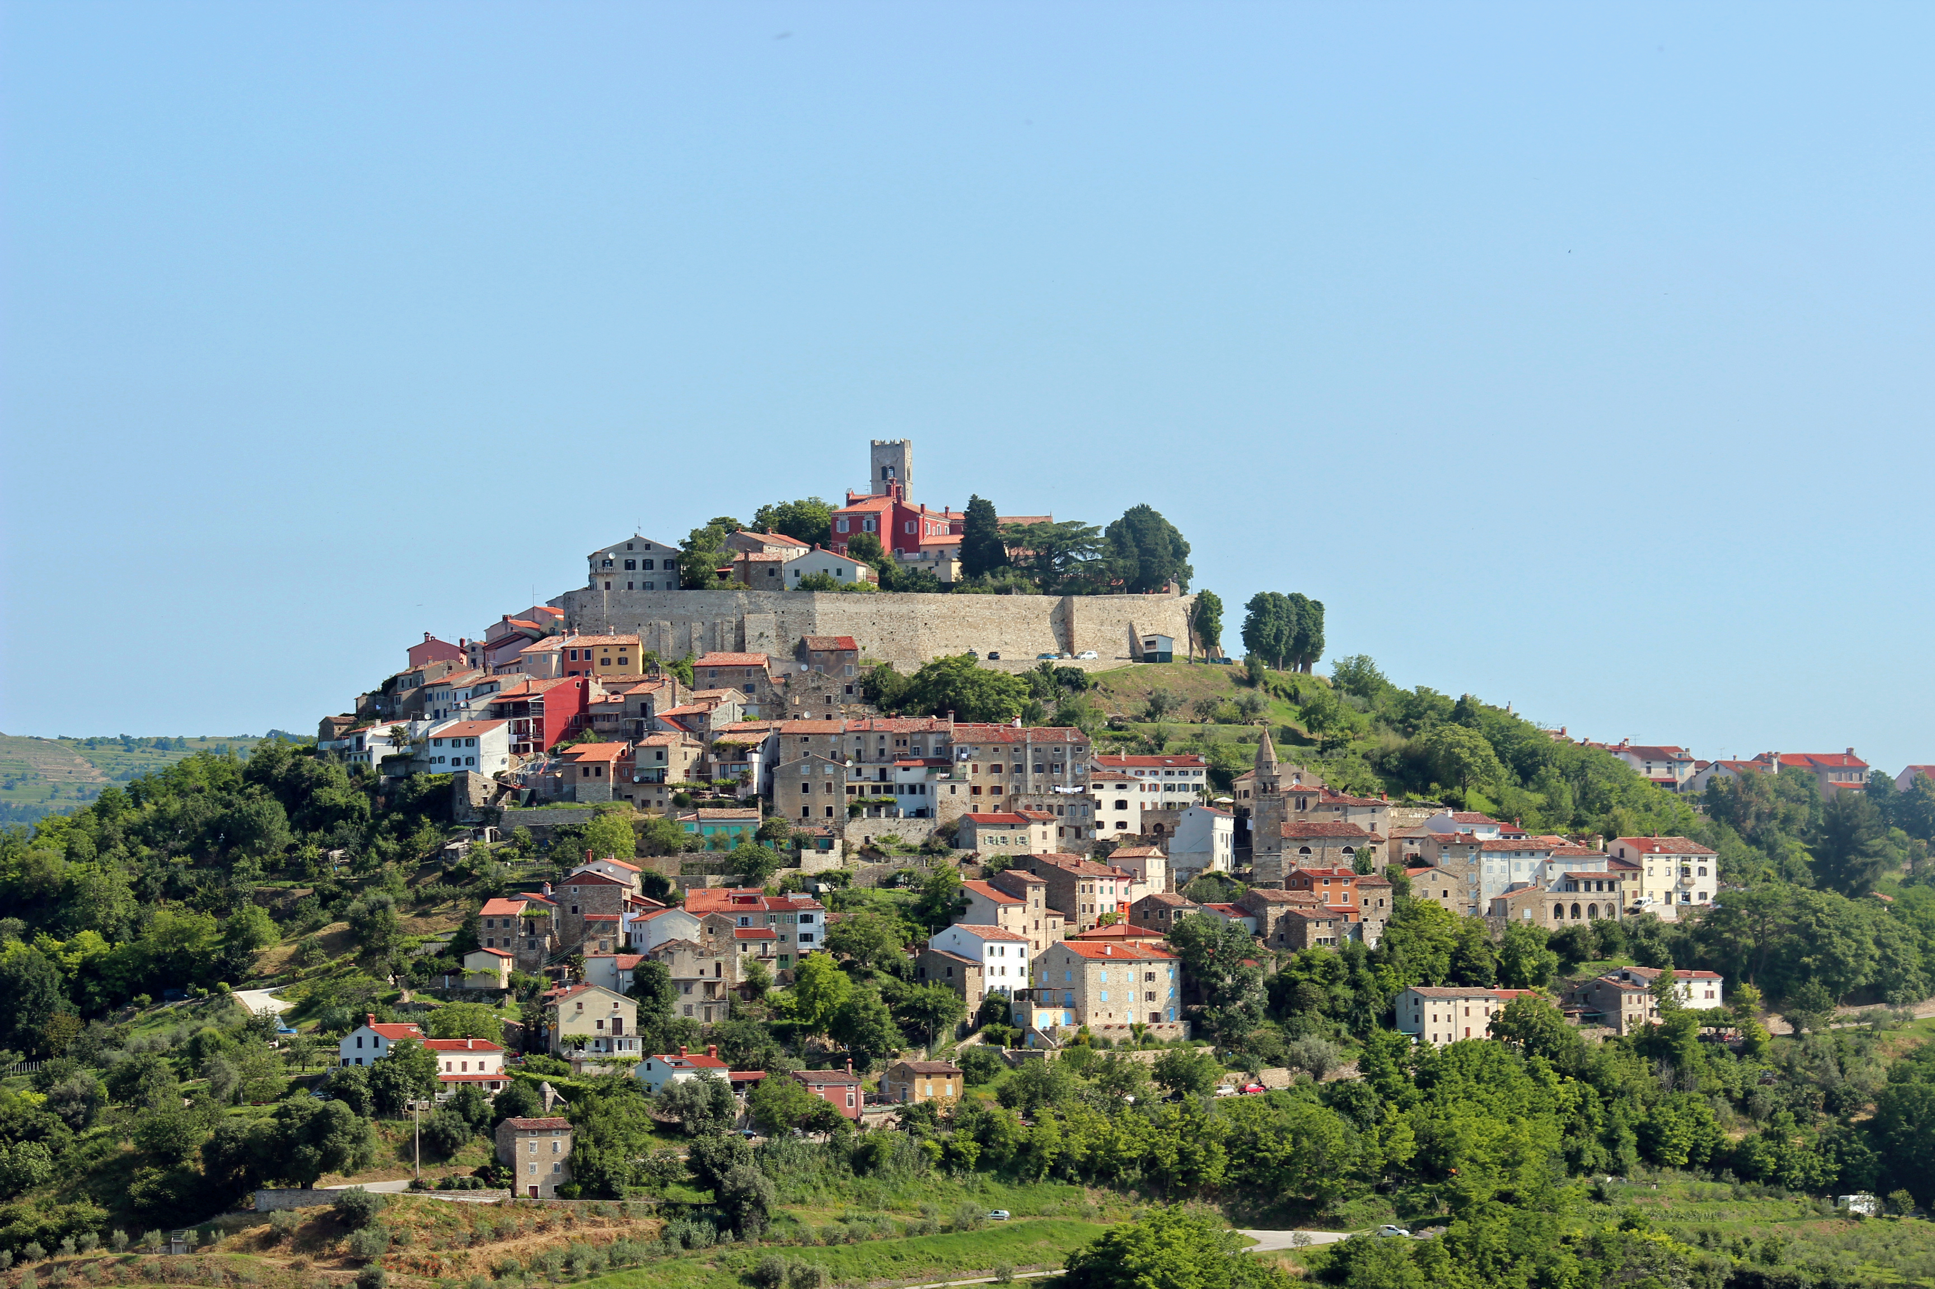
Hum – the smallest town in the world – 23 inhabitants

Slide 14
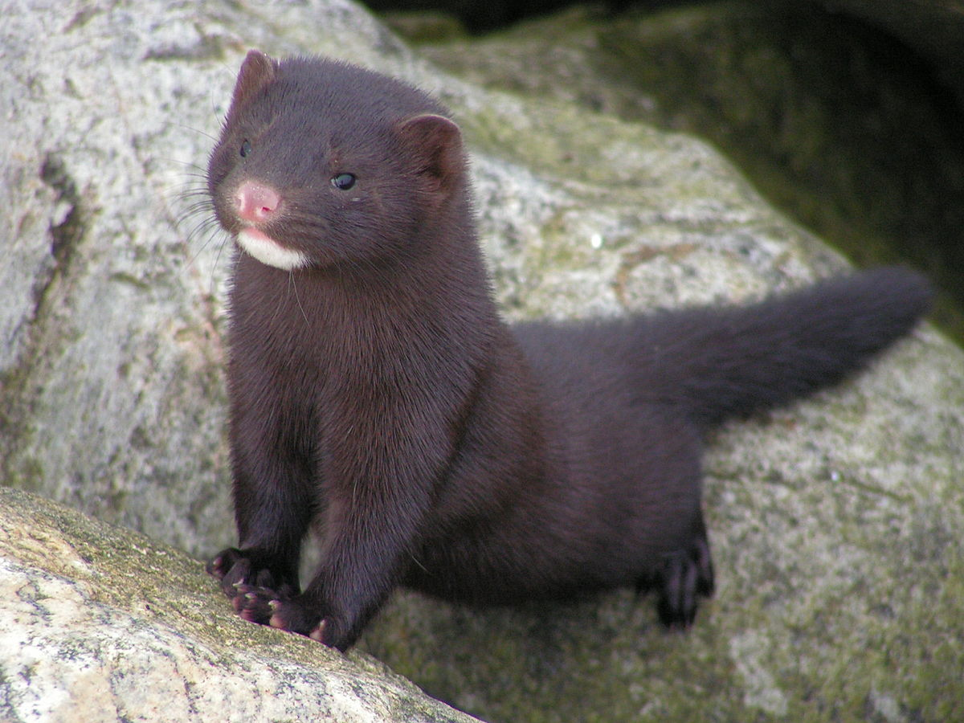
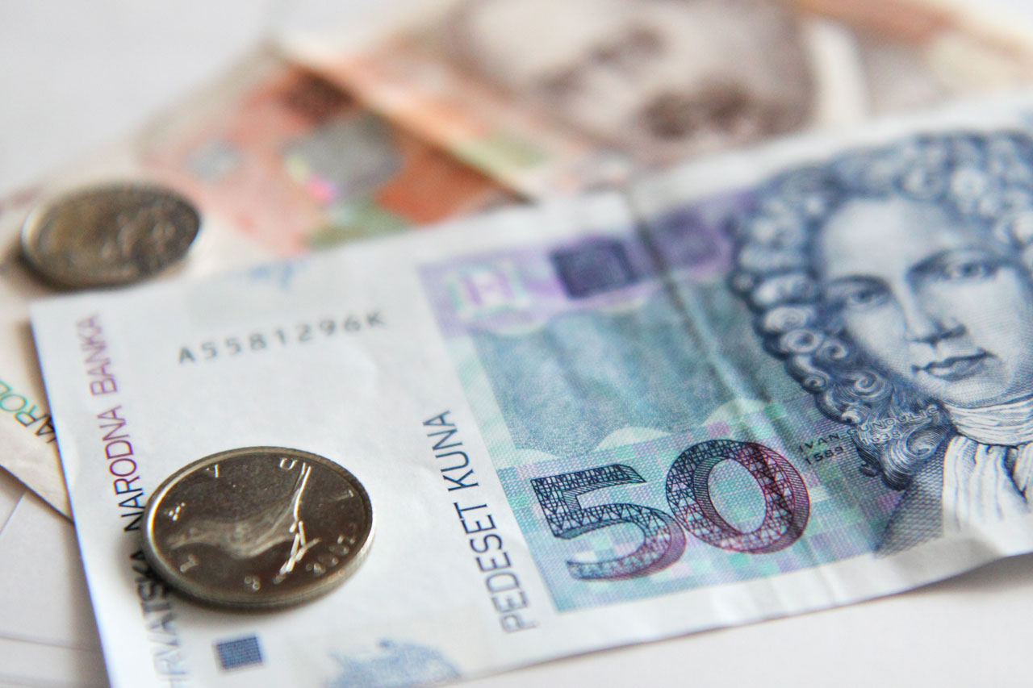
Croatia's currency – kuna – marten in English

Slide 15
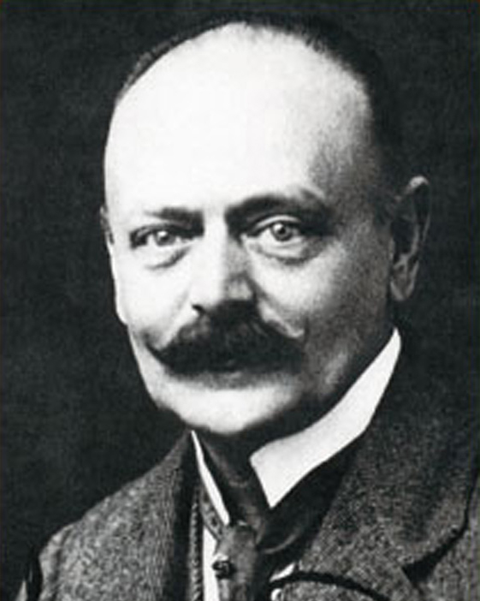
mechanical ball pen – Slavoljub Penkala

Slide 16
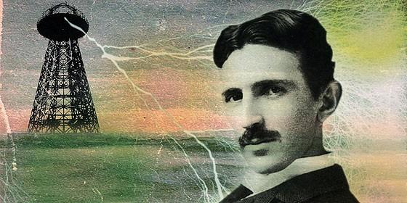
Nikola Tesla – the inventor who changed the world – 1856 - 1943
the father of alternating current technology, production and transmission of electrical energy as we know it today
more than 700 patents/inventions

Slide 17
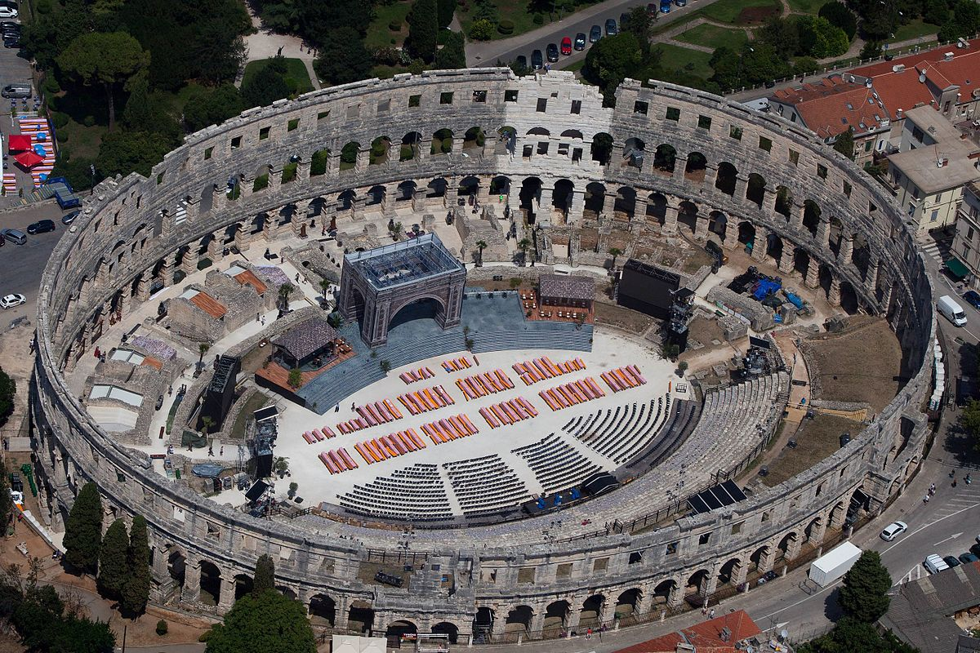
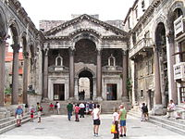
Arena Pula – Roman heritage – built in the 1st century – amphitheatre – 20 000 spectators
Diocletian Palace in Split – Roman heritage – UN world heritage - built in 300th year by emperor Diocletian
Arena Pula
Diocletian Palace

Slide 18
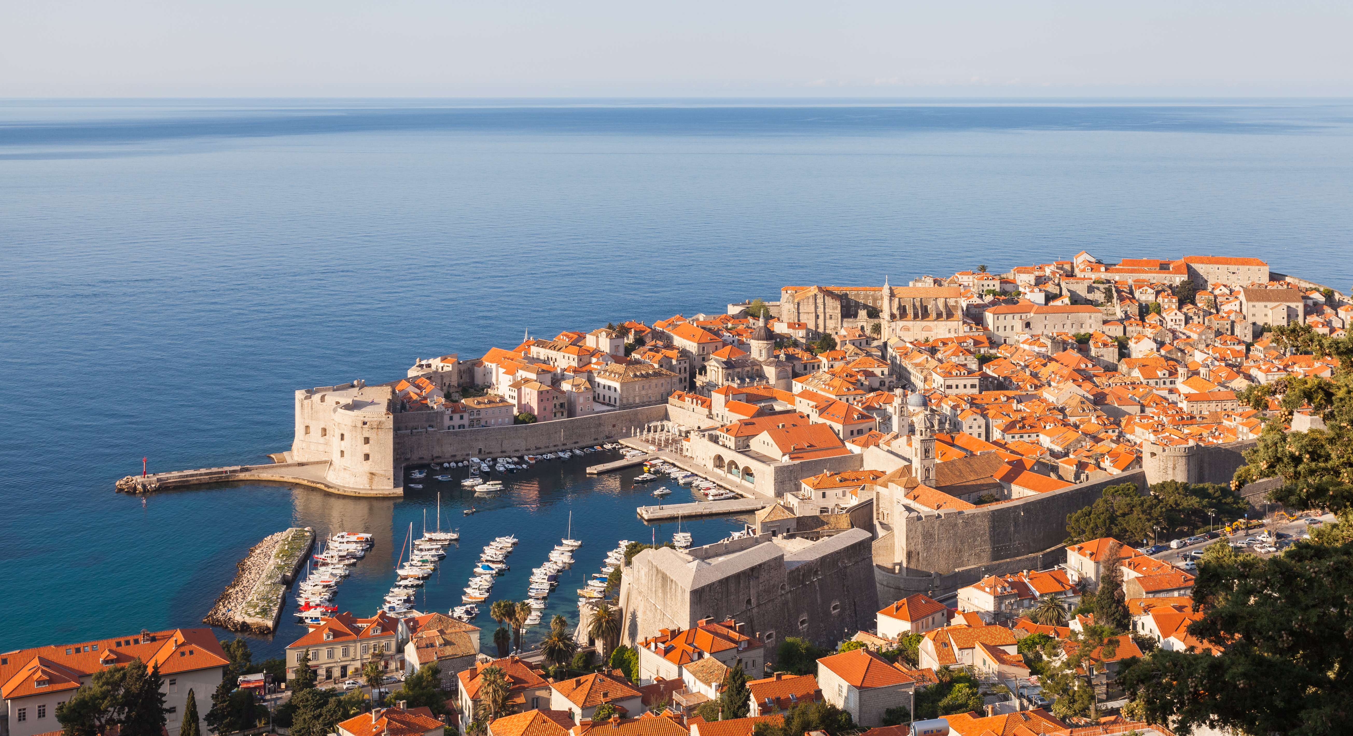
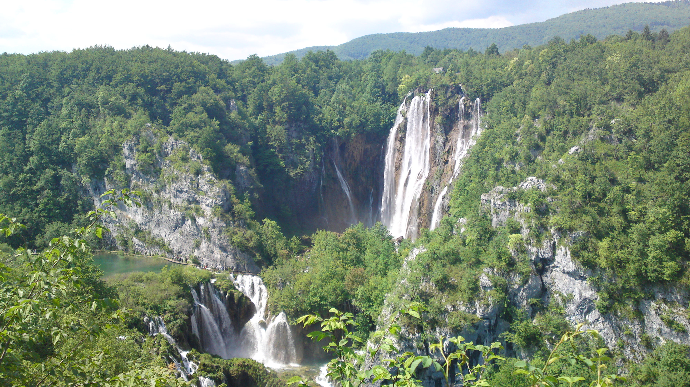
Dubrovnik - Old city of Dubrovnik – also UN world heritage
Plitvice Lakes – national park– UN world heritage
Šibenik Cathedral – UN world heritage
Dubrovnik
Plitvice Lakes
Šibenik Cathedral

Slide 19
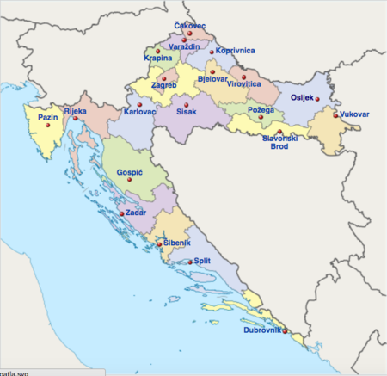
LITTLE COUNTRY WITH A BIG HEART.
https://www.youtube.com/watch?v=xvBEW-aLGSs

